Slide 1
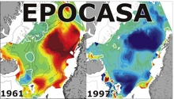
A role for volcanoes in future climate assessments?
Outline Background Methods Results Summary
BJERKNES FTI
Ingo Bethke (ingo.bethke@bjerknes.uib.no)
Stephen Outten, Pete Thorne, Ed Hawkins,
Sebastian Wagner, Michael Sigl, Odd Helge Otterå
Notes:
– talk about “volcanic impact on future climate”
– work has started as a Bjerknes Fast Track Initiative

Slide 2
Outline
Outline Background Methods Results Summary
Background
Volcanic impact on climate
Future climate projections
Methods
proxy-based future volcanic forcing for use in climate projections
Results
21st Century simulations with proxy-based volcanic forcing versus standard projections with zero or constant volcanic forcing
Notes:
– start with some background on volcanic impact on climate and past volcanic activity
– future climate projections with emphasis on poor representation of volcanic effects
– introduce stochastic approach for a more realistic representation of volcanic effects
– show results from 21st Century simulations with realistic volcanic forcing and compare those to standard projections that use no or constant volcanic forcing

Slide 3
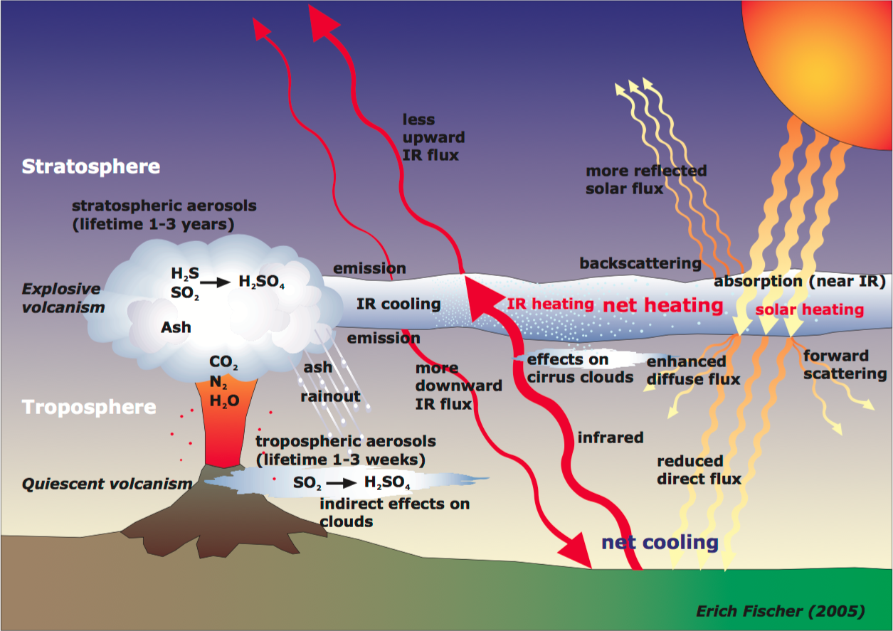
Volcanic impact on climate
Outline Background Methods Results Summary
Reflects incoming shortwave radiation (cooling at surface)
Absorbs longwave radiation from surface (warming in stratosphere)
Notes:
– volcanic eruptions affect climate in many ways, but not all eruptions have a significant climate impact
– in order to have a significant climate impact, it is important that sulfate emissions reach up into the stratosphere where the sulfate gas SO2 is condensed into H2SO4 sufuric acid which is an aerosol
– the process is also active in the troposphere but there volcanic aerosols are washed out within a few weeks, while the volcanic aerosols can survive a few years in the stratosphere
– once in the stratosphere, the volcanic aerosols are dispersed around the globe, in many cases globally but sometimes more in one hemisphere than the other, and this hemispheric asymmetry shapes the climate impact
– the main effect of the aerosols is to reflect incoming radiation from the sun, leading to less radiation reaching the surface and therefore a cooling of the surface
– an important secondary effect is that the volcanic aerosols absorb longwave radiation emitted from the surface and by this warm the stratosphere, leading to changes in the atmospheric circulation that I will return to later

Slide 4
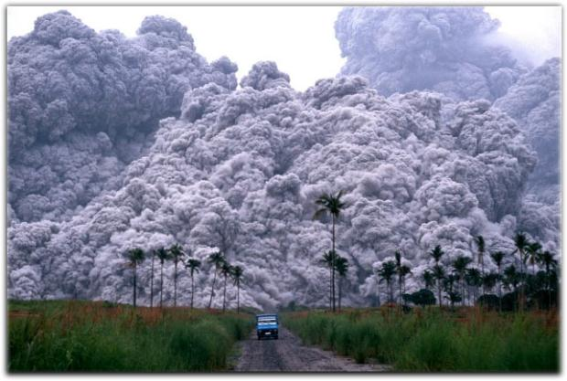
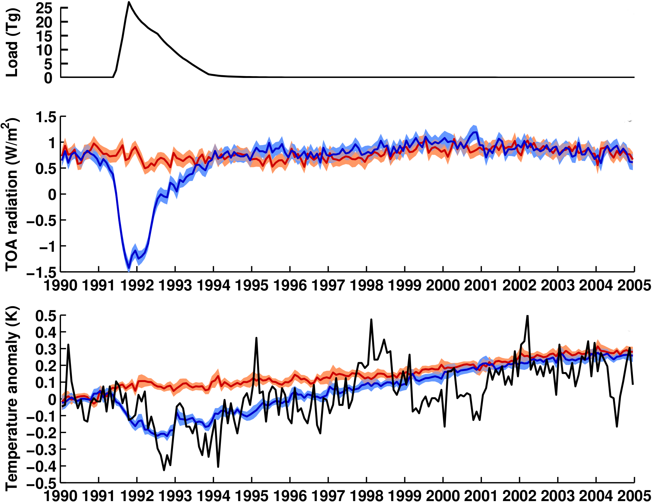
Global radiation and temperature response
Outline Background Methods Results Summary
Mt. Pinatubo eruption
HIST
60 member NorESM all-forcing ensemble
NO-PINATUBO
as HIST, but no Mt. Pinatubo forcing
NASA GISS OBS
dTOA model = 2.2 W/m2
dTOA obs = 2.7±1 W/m2 (Minnes et al. 1993)
El Niño
anthropogenic warming
warming
pause
accelerated warming
La Niña
anomalies computed
relative to 1990
de-seasoned
ensemble averaged
dT model = 0.3 K
dT obs = 0.4 K (Ridley et al. 2014)
Notes:
– generic prototype eruption used in majority of impact studies
– verification simulations with NorESM
– difficult to isolate volcanic impact from observations due to presence of internal climate variability
– using simulation ensembles it is possible to average internal climate variability out, so one is left with a clean signal of the climate impact
– top panel shows stratospheric mass of volcanic aerosols
– middle panel shows a radiative response at the top of the atmosphere of 2-3 W/m2
– this results into a cooling of a slightly less than 0.5 K at the surface
– maximum surface cooling delayed in time relative to the forcing due to the thermal inertia of the oceans
– it takes more than a decade for the surface temperatures to recover
– depending on the time period one looks at, volcanic eruptions can both facilitate negative and positive shortterm climatic trends
– also shown here is global temperature from observations, which exhibits internal climate variability (such as the 98 El Nino) on top of the externally forced changes

Slide 5

Size matters!
Outline Background Methods Results Summary
Tropical
N. Hemis.
S. Hemis.
Edvard Munch 1893
data: Sigl et al. 2015, Science
Notes:
– Mt. Pinatubo was among the largest eruptions in the last 100 years, but is still small compared to eruptions that occurred during the last 1000 years
– examples: Samalas eruption in Indonesia in 13th Century that was 8 times as large as Pinatubo, or, the Tambora eruption 200 years ago that was 3-4 times as large and the Krakarao eruption in late 19th Century may have inspired this famous painting
– most knowledge about past climate activity is from volcanic aerosol depositions in ice cores
– with the help of calibrated scaling relations one can guess stratospheric aerosol load from ice core deposition
– reconstruction based on ice cores from both hemisphere and depending on the relative amount of sulfate in the different cores, one can infer whether an eruption was tropical or extratropical

Slide 6
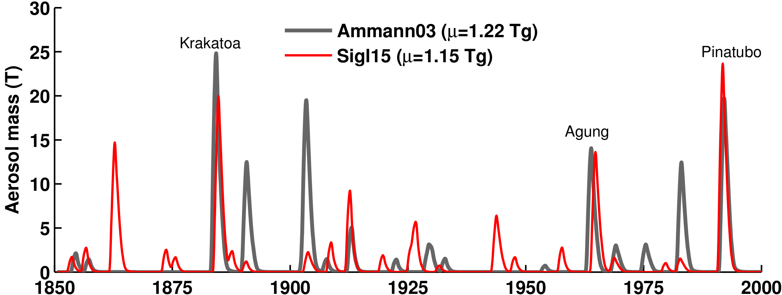
Size matters!
Outline Background Methods Results Summary
optical measurem.
ice core
20th Century was relatively quiet!
N. Hemis.
Tropical
S. Hemis.
data: Sigl et al. 2015, Science
Notes:
– if we zoom in to the last 150 years, then large uncertainties in the ice core reconstructions become apparent
– the last century was relative quite, in particular during the early 20th Century warming period
– nevertheless their is evidence that the modest activity has shaped multidecadal climate variability during the decades and I will come back to that point

Slide 7
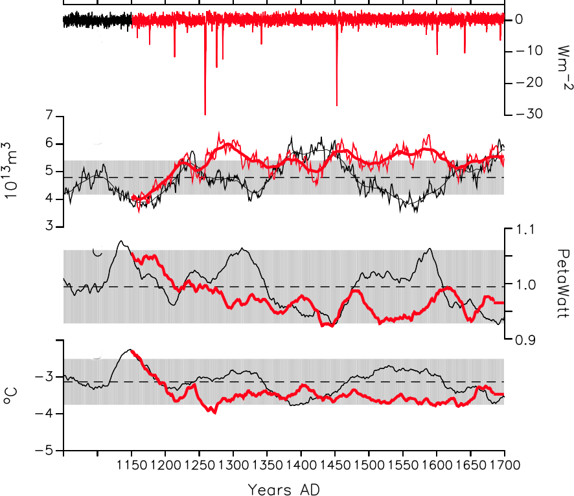
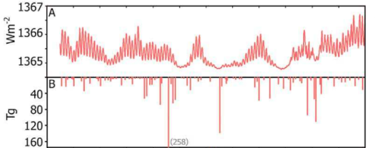

Little ice age triggered by volcanism?
Outline Background Methods Results Summary
Last millennium simulations with/without volcanic forcing (Miller et al. 2012, GRL)
solar forcing
volcanic forcing
model
volcanic forcing
NH sea ice volume (Sept.)
obs
proxy sea ice extent
northward ocean heat transport at 26N
summer land-temperature NA/Arctic
cluster of large eruptions pushed climate over tipping point
positive sea ice feedbacks important for sustaining cold climate

Slide 8
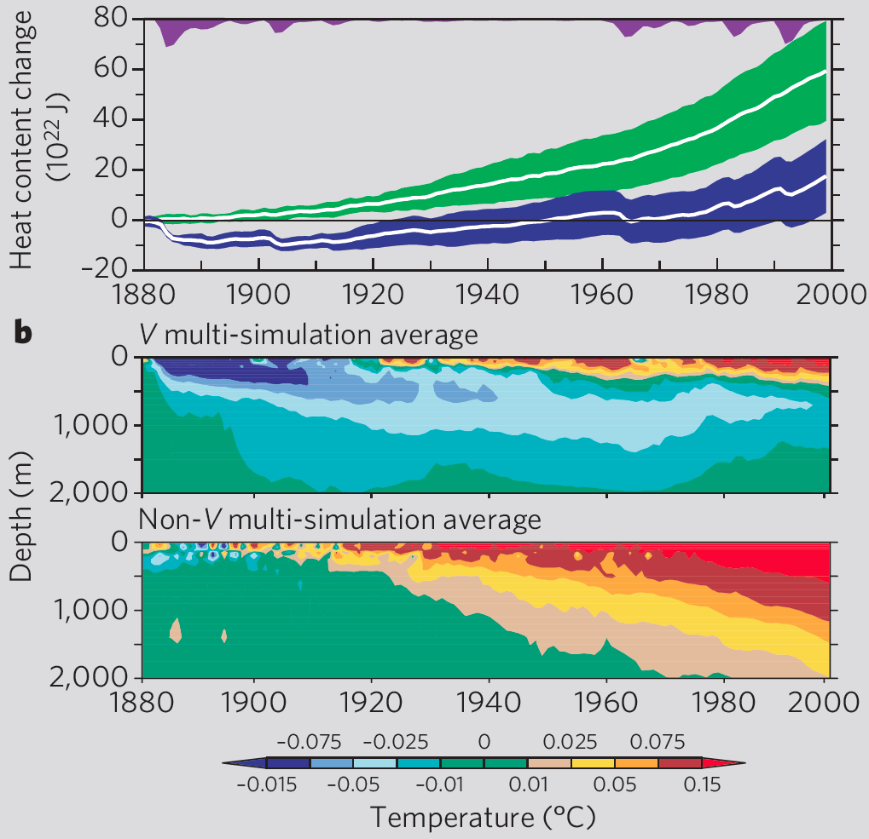
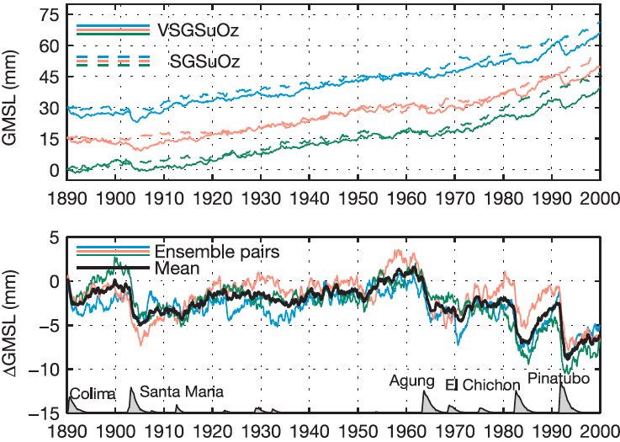
Persistent volcanic signatures in the world oceans
Outline Background Methods Results Summary
Global ocean heat content
Global mean sea level
Church et al. 2005, Nature
Gleckler et al. 2006, Science

Slide 9
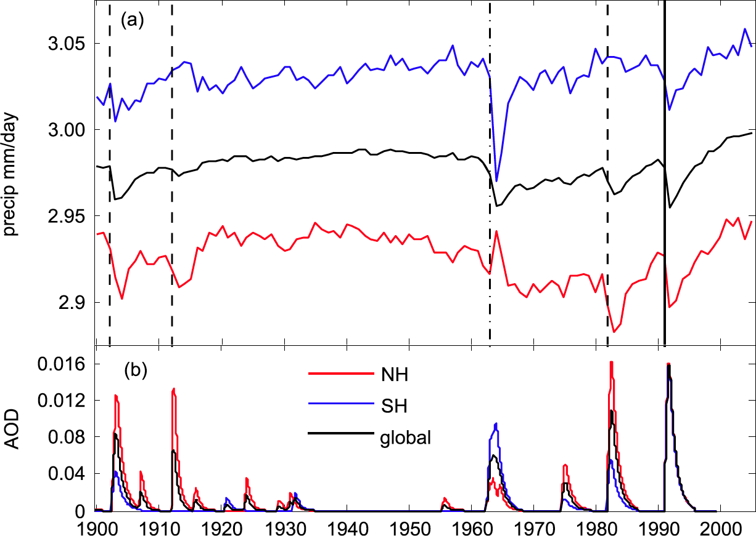
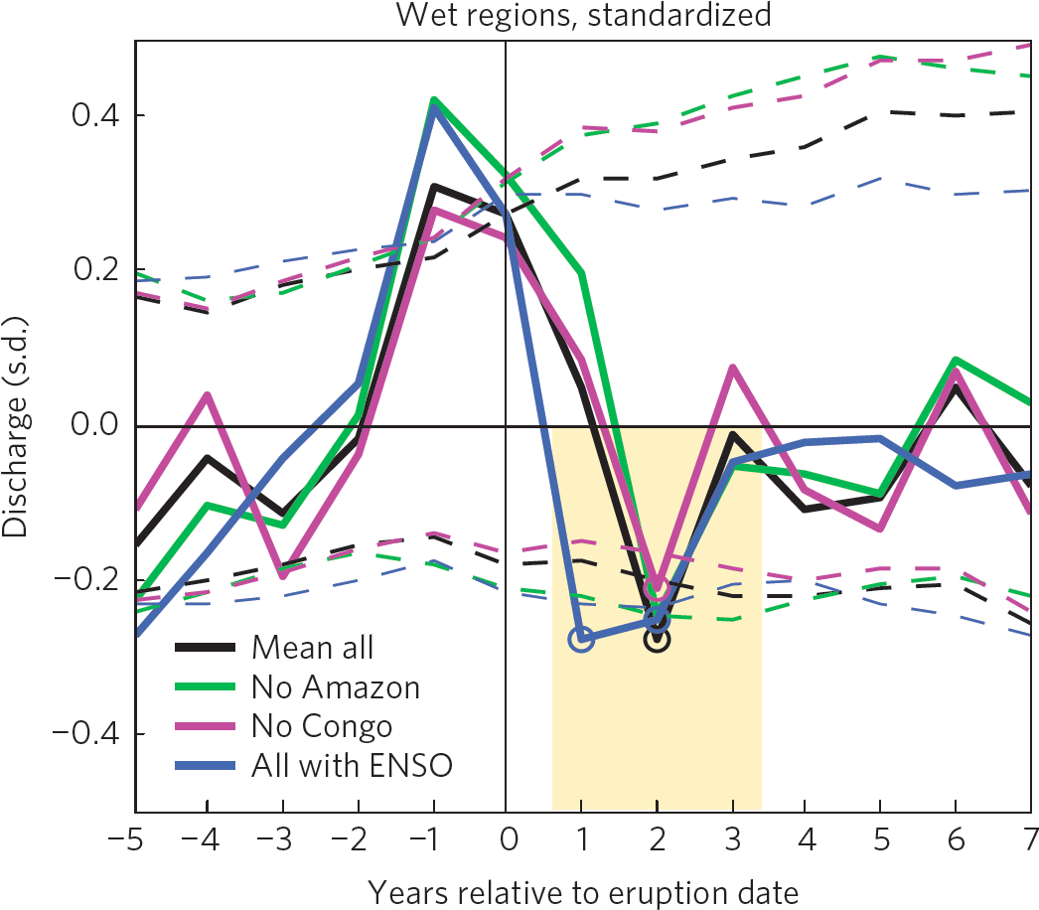
Spin-down of the global hydrologic cycle
Outline Background Methods Results Summary
Global and hemispheric precipitation from CMIP5 models
Observed river discharge
Iles et al. 2014, Nat. Geosci.
Iles et al. 2014, Environ. Res. Lett.

Slide 10
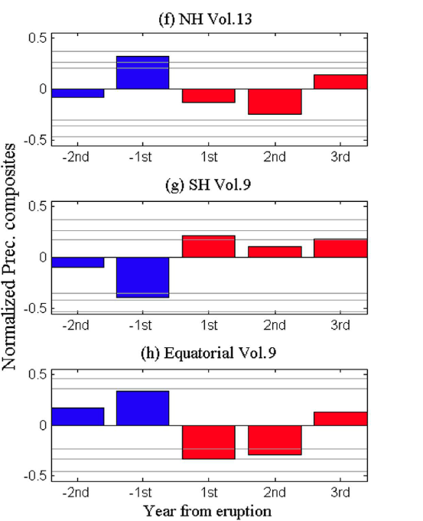
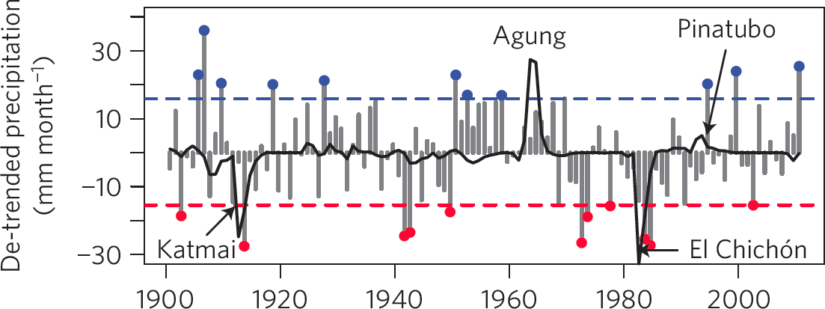
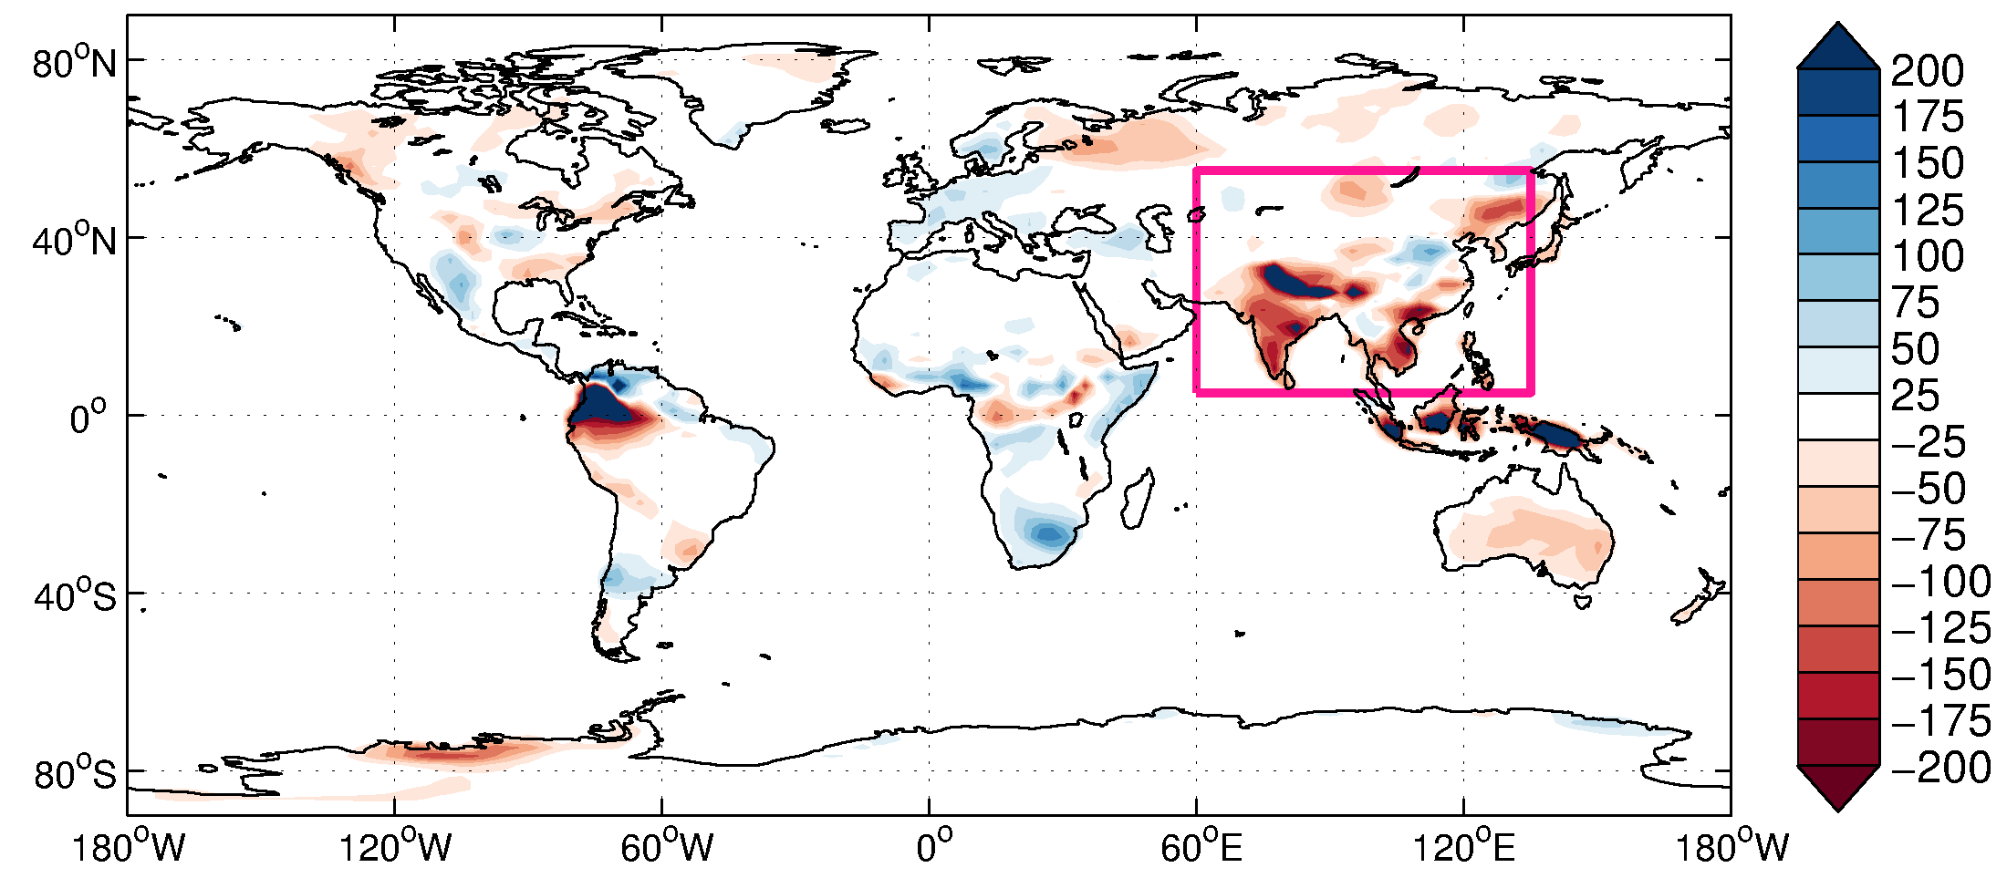
Monsoon response to hemispherically asymmetric forcing
Outline Background Methods Results Summary
East Asian summer monsoon
Sahelian rainfall
NH-SH
Haywood et al. 2013, Nat. Clim. Change
NorESM Pinatubo response (summer total)
wet
1470–1999 Recon. Prec.
Liu et al. 2016, Nature
dry
NH/tropical eruption -> wet Sahel, dry East Asia
SH eruption -> dry Sahel, wet East Asia

Slide 11
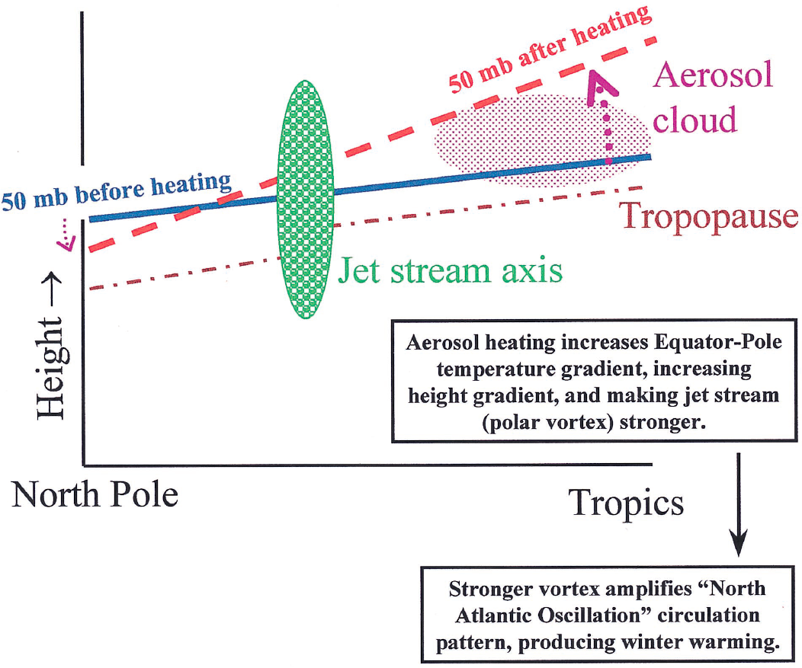
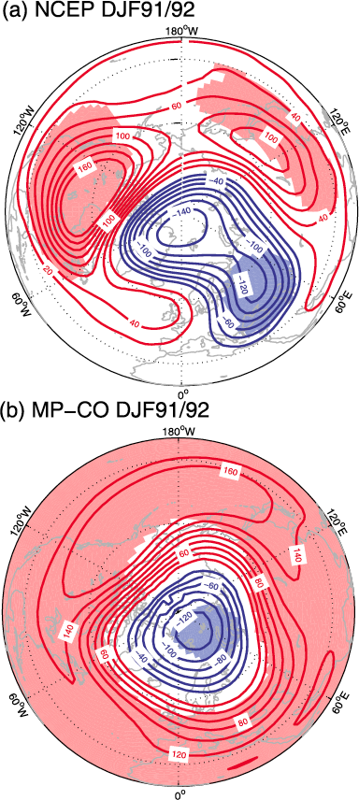
Positive NAO atmospheric circulation response
Outline Background Methods Results Summary
obs
model
Robock 2000, Rev. Geophys.
Otterå 2008, Adv. Atmos. Sci.

Slide 12
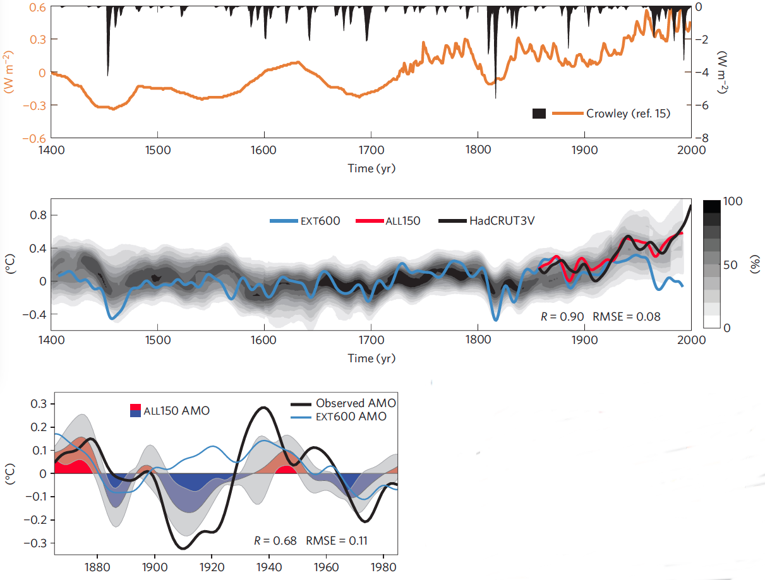
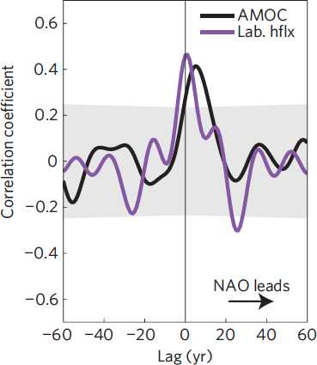
Atlantic Multidecadal Variability
Outline Background Methods Results Summary
Historical AMV reproduced in all-forcing simulations with the Bergen Climate Model
Otterå et al. 2010, Nat. Geosci.

Slide 13
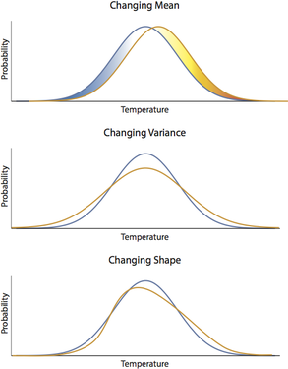
Future climate projections
Outline Background Methods Results Summary
Changes in climate probability distribution
Changes in the frequency of climate extremes aren't just about the average. (Andy Rhines)
http://www.stochtastic.com/climate-variability-and-extremes.html

Slide 14
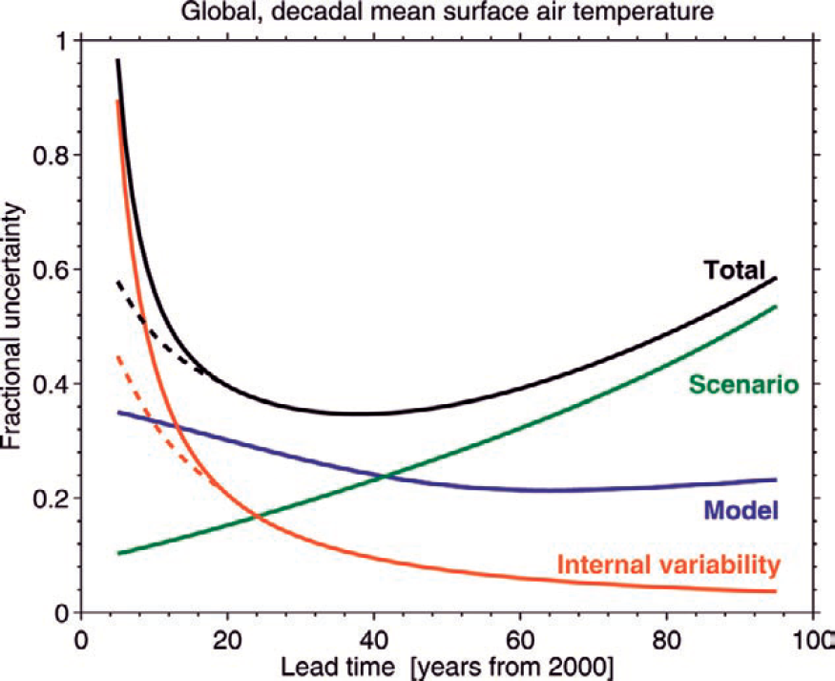
Future climate projections
Outline Background Methods Results Summary
Changes in climate probability distribution
Projection uncertainty
external (solar+volcanic)
forcing uncertainty?
Hawkins & Sutton 2009, AMS
Climate assessments do currently NOT consider future volcanic forcing uncertainty!
Changes in the frequency of climate extremes aren't just about the average. (Andy Rhines)
http://www.stochtastic.com/climate-variability-and-extremes.html

Slide 15
Future climate projections
Outline Background Methods Results Summary
IPCC AR5 on near-term climate predictions (Kirtman et al. 2013):
  Volcanic eruptions are a potential source of uncertainty in our predictions.
  Eruptions cannot be predicted in advance, but they will occur, causing shortterm climatic impacts on both local and global scales.
  In principle, this potential uncertainty can be accounted for by including random eruptions, or eruptions based on some scenario in our near-term ensemble climate predictions.
  This area of research needs further exploration.

Slide 16
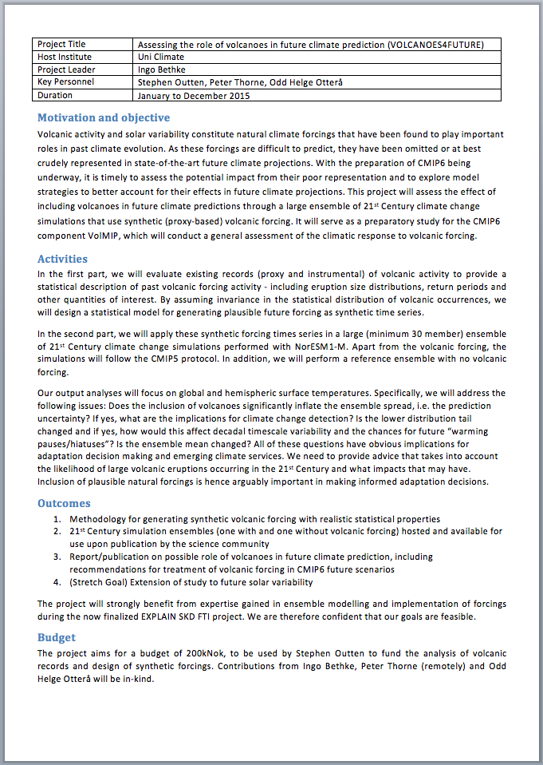
Bjerknes Fast Track Initiative
Outline Background Methods Results Summary
Objective
Demonstrate that it’s possible to account for future volcanic forcing uncertainty in probabilistic climate assessments (proof-of-concept).
Identify socio-economically relevant aspects of climate change projections for which the inclusion of volcanic effects makes a significant difference.
Approach
Perform a large ensemble of 21st Century simulations that sample from a proxy-constrained probability space of future volcanic forcing.
APPROVED

Slide 17
How to include volcanoes in climate projections?

Slide 18
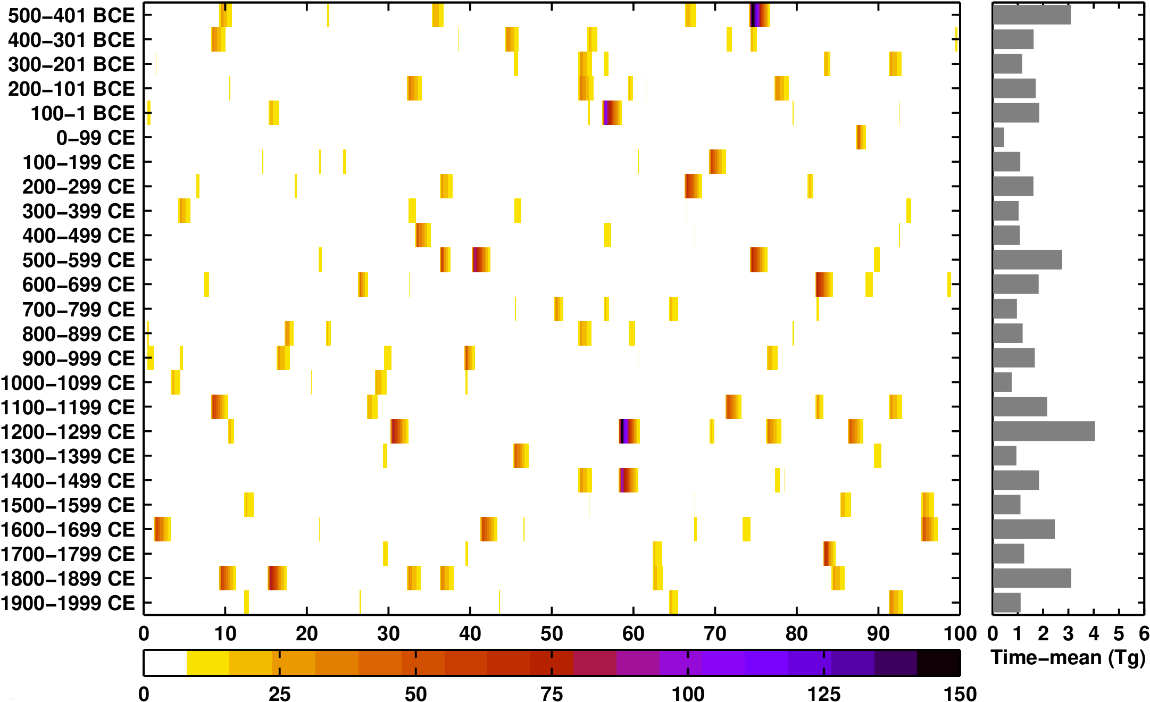
Construction of proxy-based volcanic forcing futures
Outline Background Methods Results Summary
Step 1 – establish catalogue of historical eruptions
283 historical eruptions events over last 2,500 years with information on magnitude (maximum stratospheric volcanic aerosol load) and location (tropical vs NH/SH extratropical)
data source:
Sigl et al. 2015,
Nature
Year of century
Stratospheric volcanic aerosol mass (Tg)

Slide 19
Construction of proxy-based volcanic forcing futures
Outline Background Methods Results Summary
Step 1 – establish catalogue of historical eruptions
283 historical eruptions events over last 2,500 years with information on magnitude (maximum stratospheric volcanic aerosol load) and location (tropical vs NH/SH extratropical)
Step 2 – create 21st Century eruption chronologies by re-sampling
for each month, test if one or more of the 283 historical eruption events are triggered – use pseudo-random numbers and assume probability of 1/(2500x12) for each event (i.e. 2,500-year return period)
repeat for a total of 60 forcing futures

Slide 20
Construction of proxy-based volcanic forcing futures
Outline Background Methods Results Summary
Step 1 – establish catalogue of historical eruptions
283 historical eruptions events over last 2,500 years with information on magnitude (maximum stratospheric volcanic aerosol load) and location (tropical vs NH/SH extratropical)
Step 2 – create 21st Century eruption chronologies by re-sampling
for each month, test if one or more of the 283 historical eruption events are triggered – use pseudo-random numbers and assume probability of 1/(2500x12) for each event (i.e. 2,500-year return period)
repeat for a total of 60 forcing futures
Stengths simple algorithm with few subjective choices statistitics converge against proxy-distribution forcing futures are uncorrelated future eruptions have historical reference | Cons representation of very large eruptions not robust because they are very rare small eruptions not captured in ice cores
Alternatives volcanic forcing generator based on extreme value theory (Ammann & Naveau 2010, JGR)

Slide 21
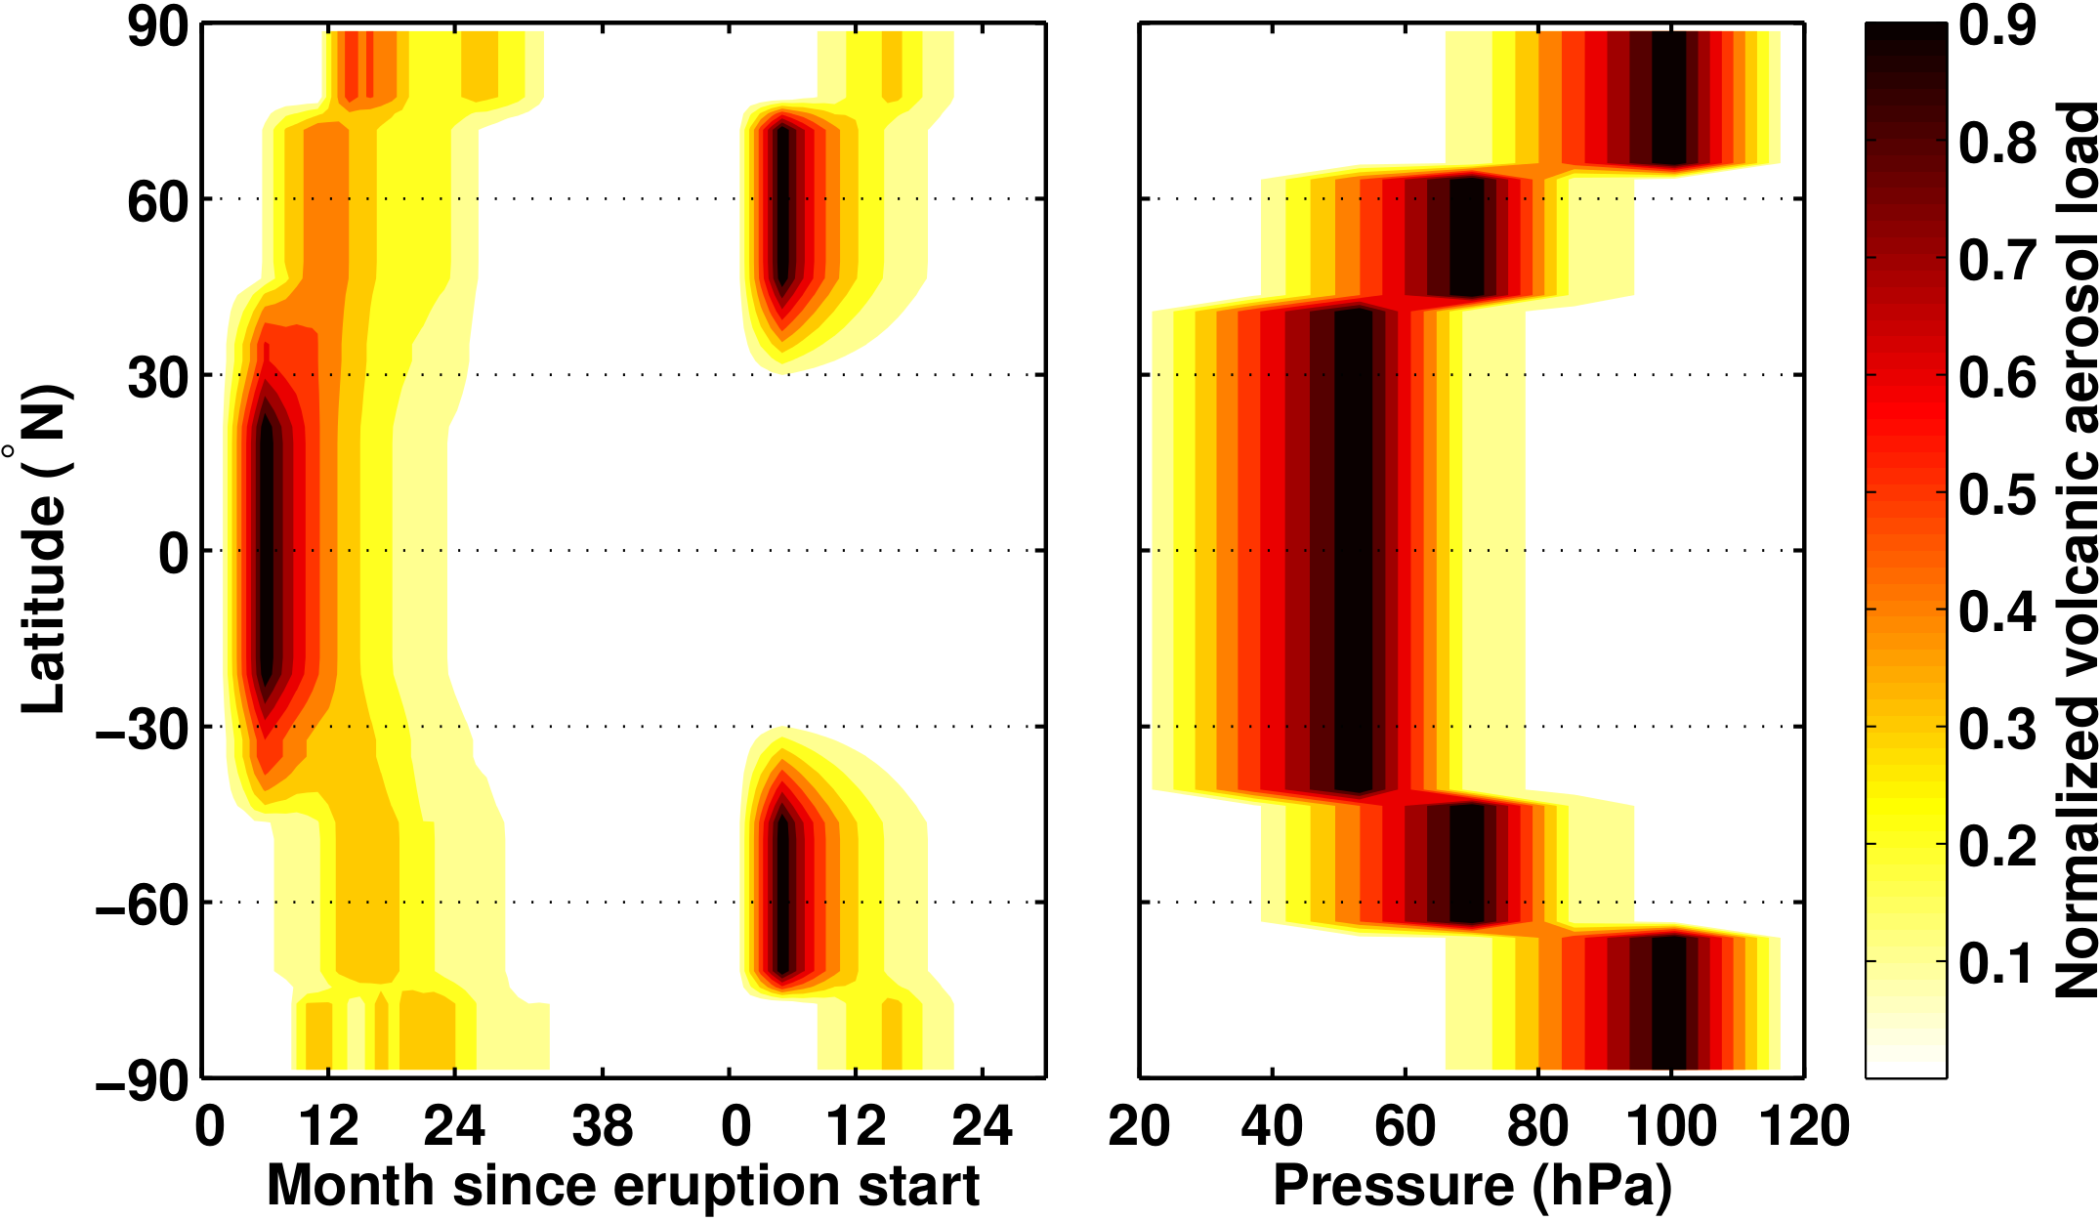
Construction of proxy-based volcanic forcing futures
Outline Background Methods Results Summary
Step 1 – establish catalogue of historical eruptions
283 historical eruptions events over last 2,500 years with information on magnitude (maximum stratospheric volcanic aerosol load) and location (tropical vs NH/SH extratropical)
Step 2 – create 21st Century eruption chronologies by re-sampling
for each month, test if one or more of the 283 historical eruption events are triggered – use pseudo-random numbers and assume probability of 1/(2500x12) for each event (i.e. 2,500-year return period)
repeat for a total of 60 forcing futures
Step 3 – convert cronologies into model forcing
use fixed shape functions that describe spatiotemperal dispersal of volcanic aerosols (Ammann et al. 2003, GRL)

Slide 22
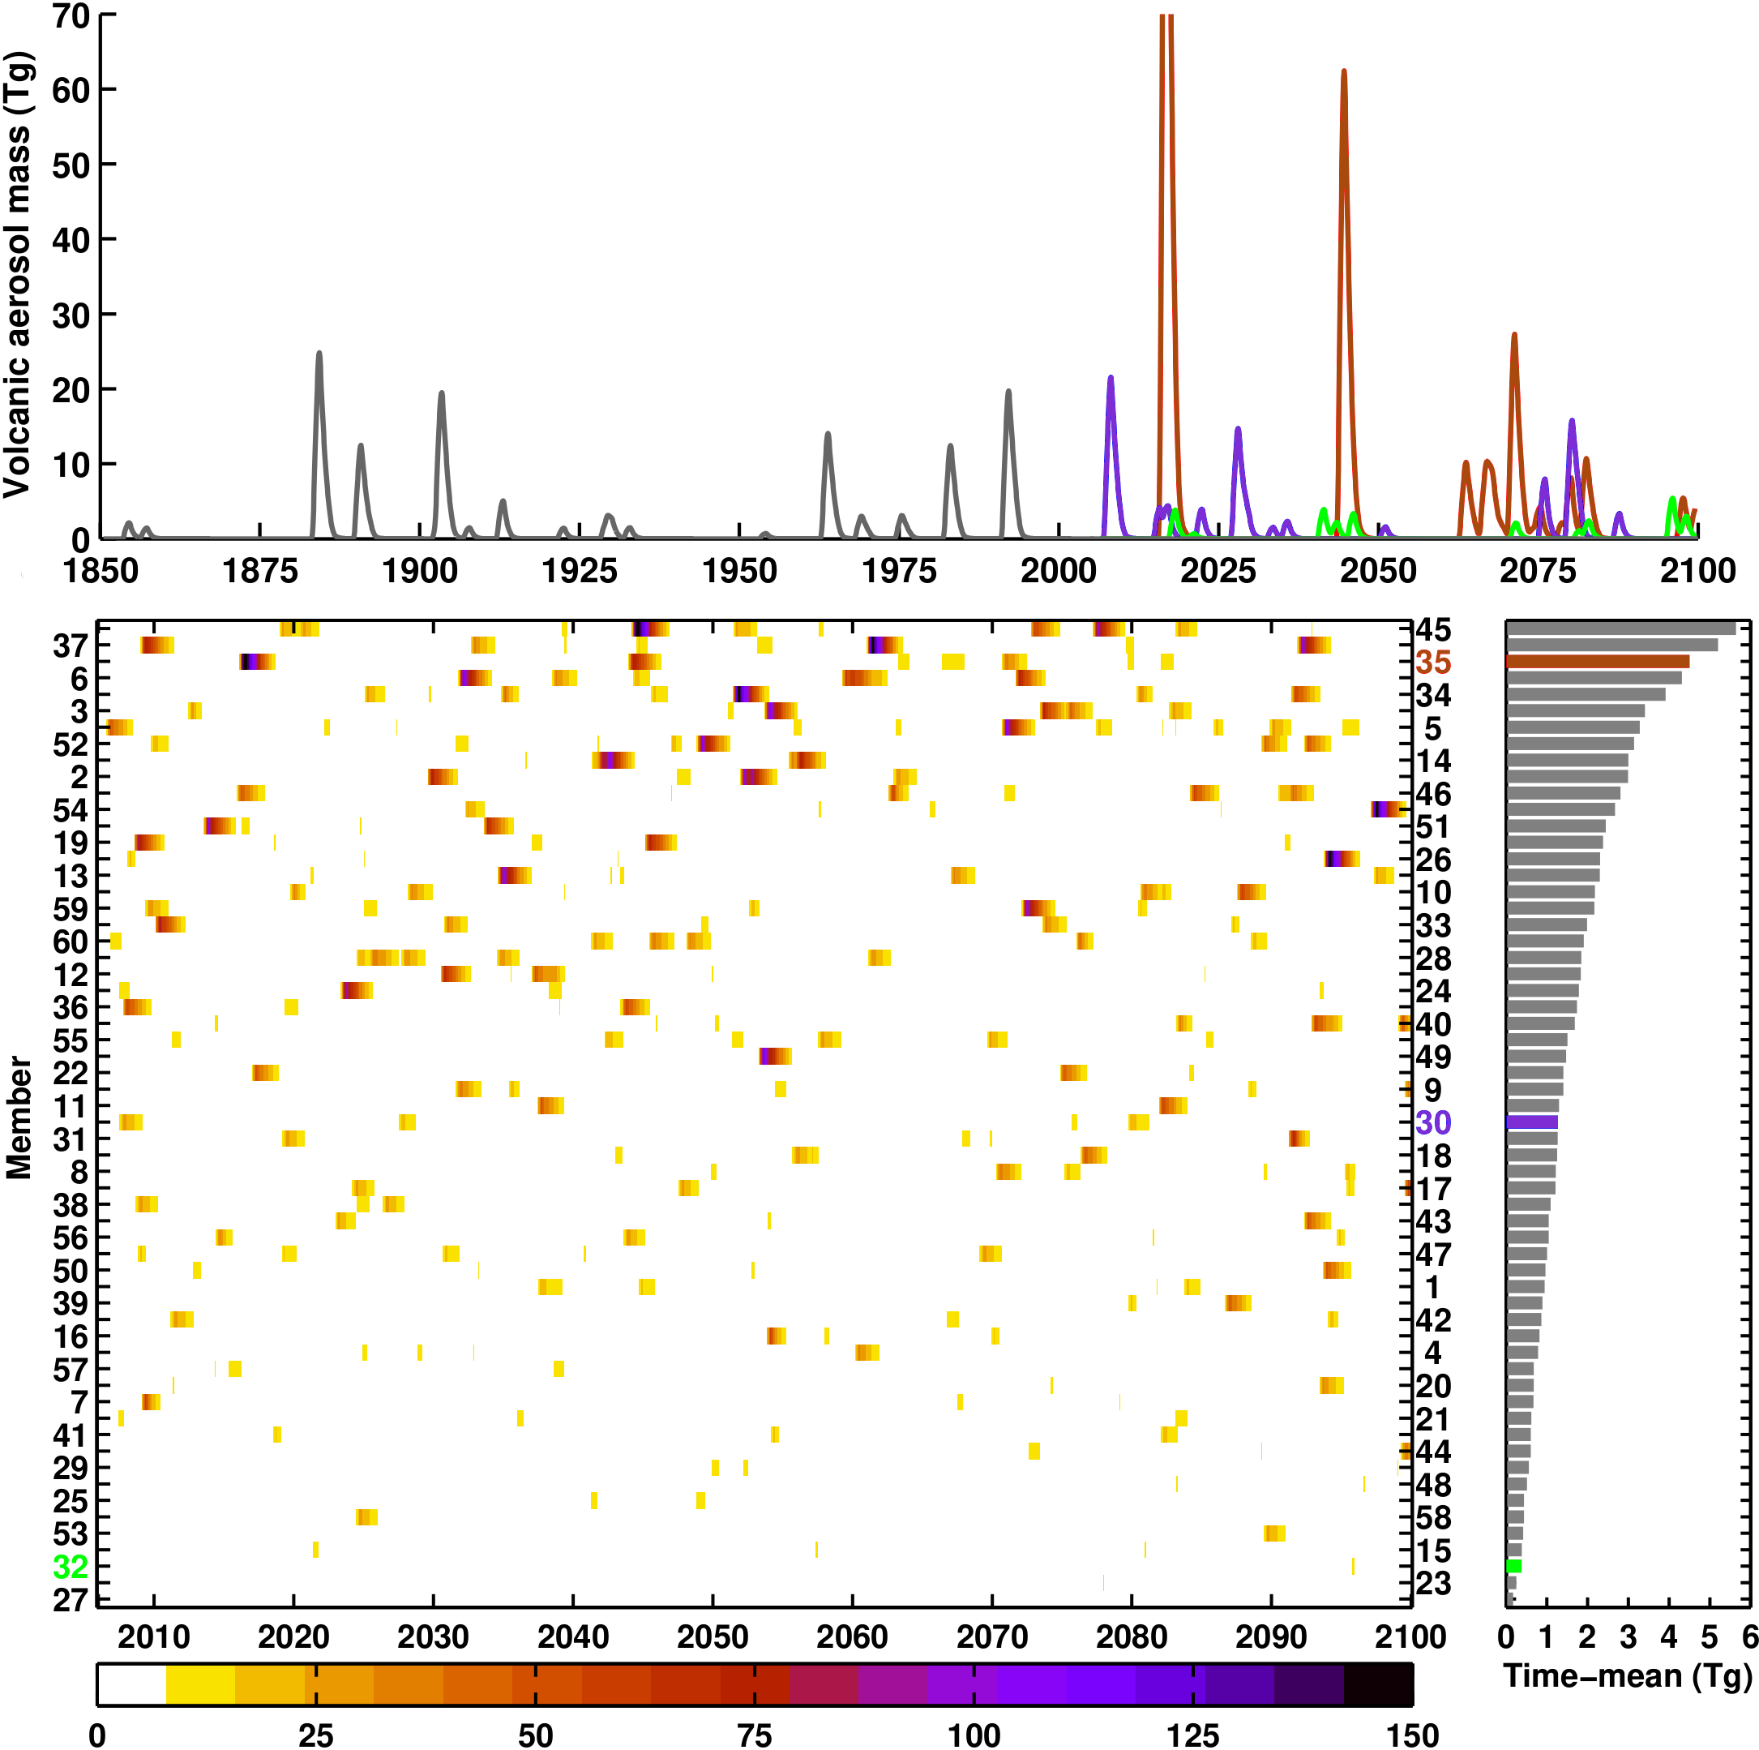
Proxy-based volcanic forcings
Outline Background Methods Results Summary
21st Century experiments
VOLC
60 member ensemble using plausible volcanic futures
RCP4.5 GHG scenario forcing
NO-VOLC
as VOLC but with volcanic forcing switched off
VOLC-CONST
20 member ensemble with volcanic forcing set constant using 1850-2000 average
Stratospheric volcancic aerosol mass (Tg)

Slide 23
Does it make a difference?

Slide 24
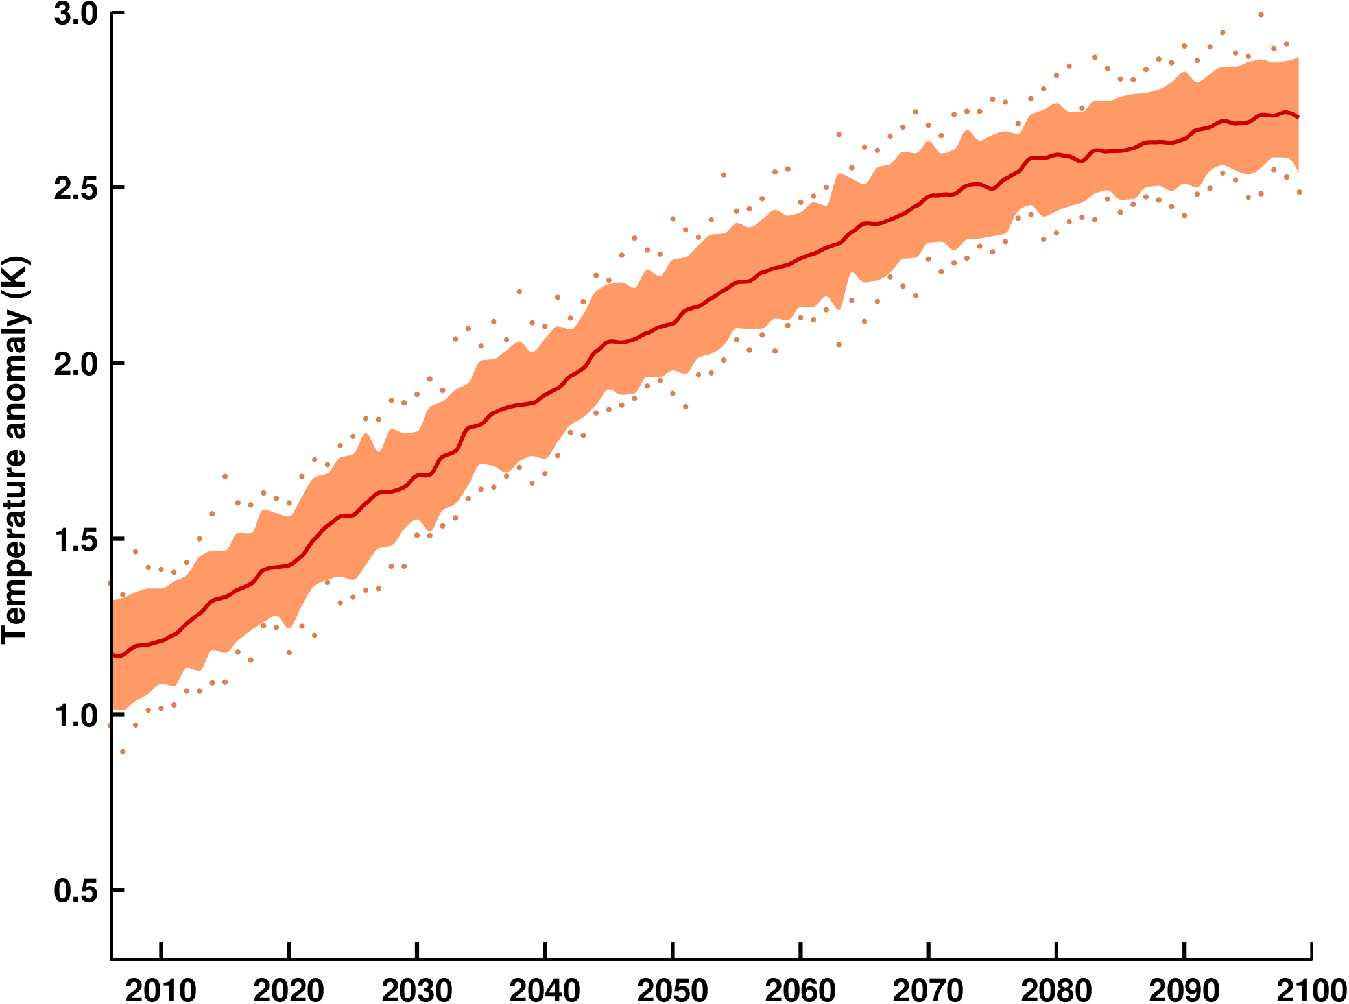
Global-mean annual surface air temperature
Outline Background Methods Results Summary
NO-VOLC
max
95%
mean
5%
min

Slide 25
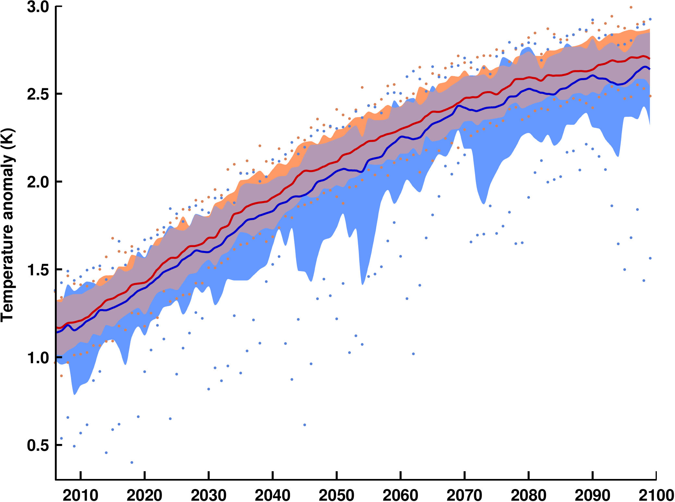
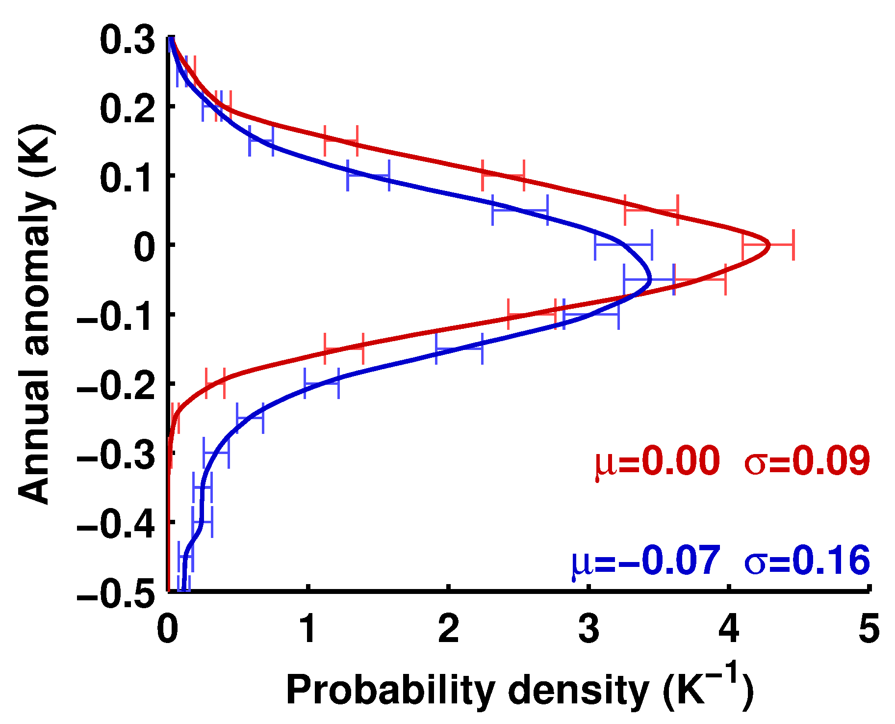
Global-mean annual surface air temperature
Outline Background Methods Results Summary
NO-VOLC
VOLC

Slide 26
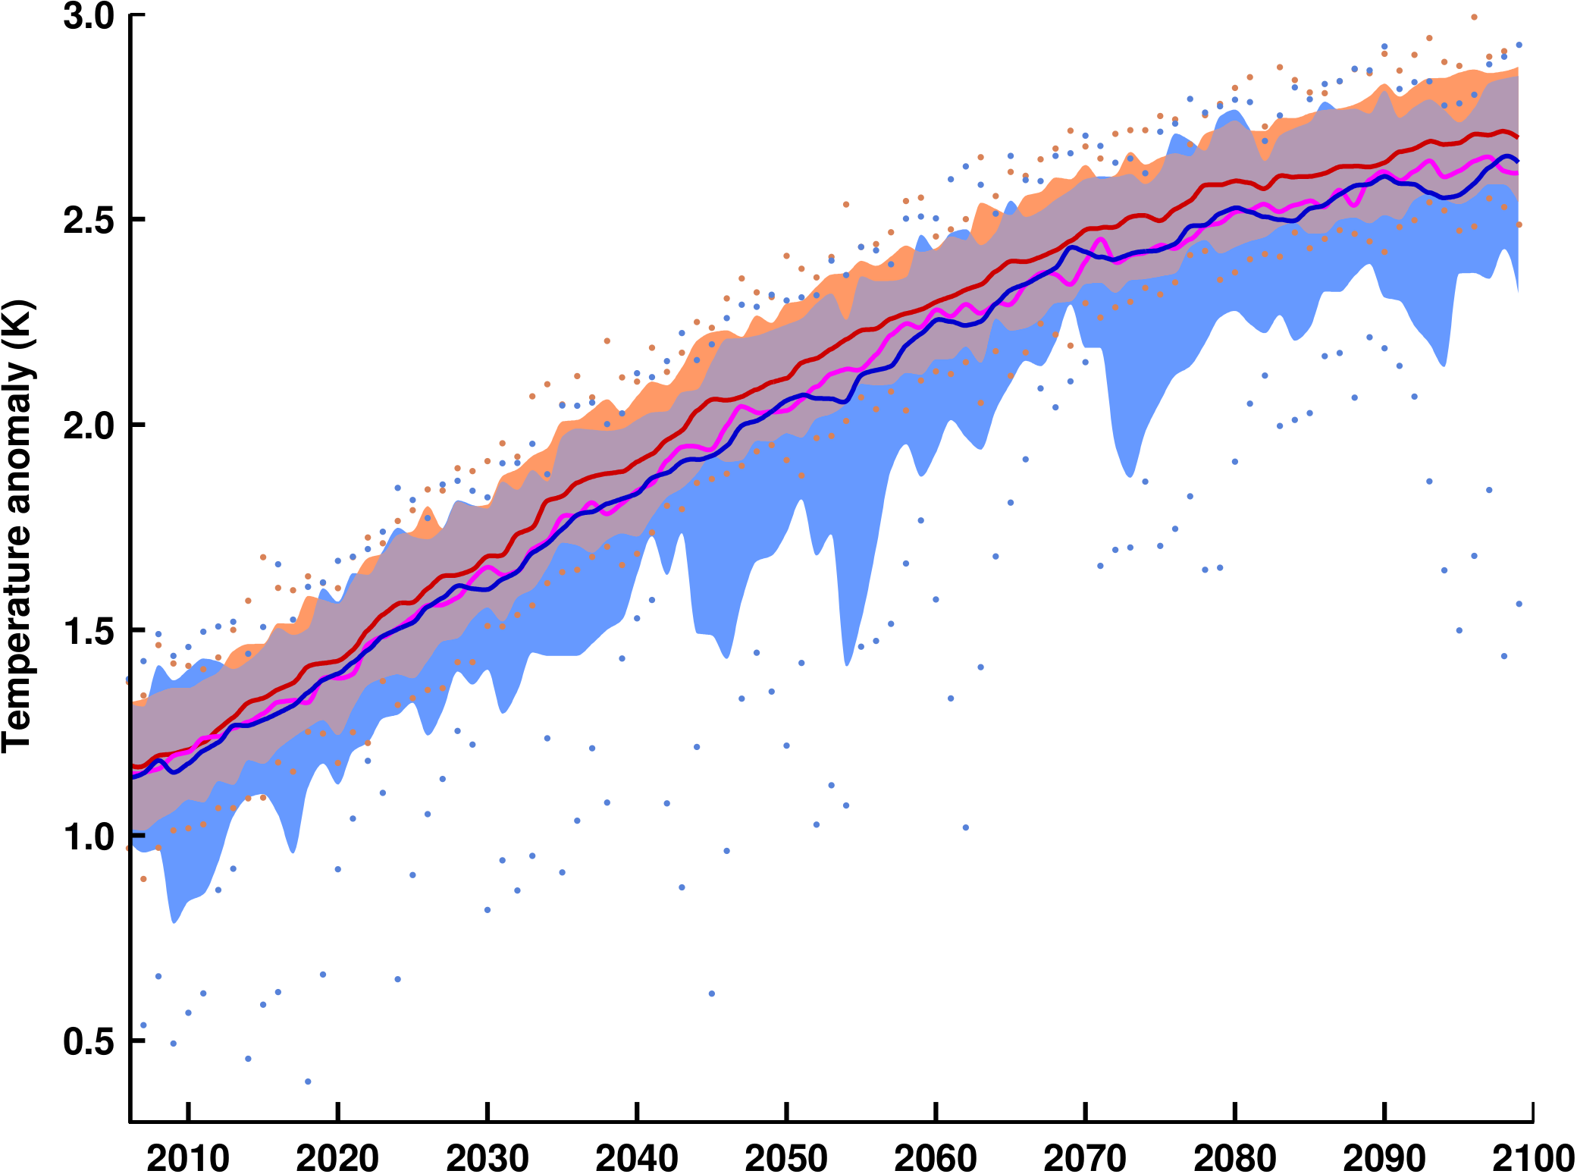
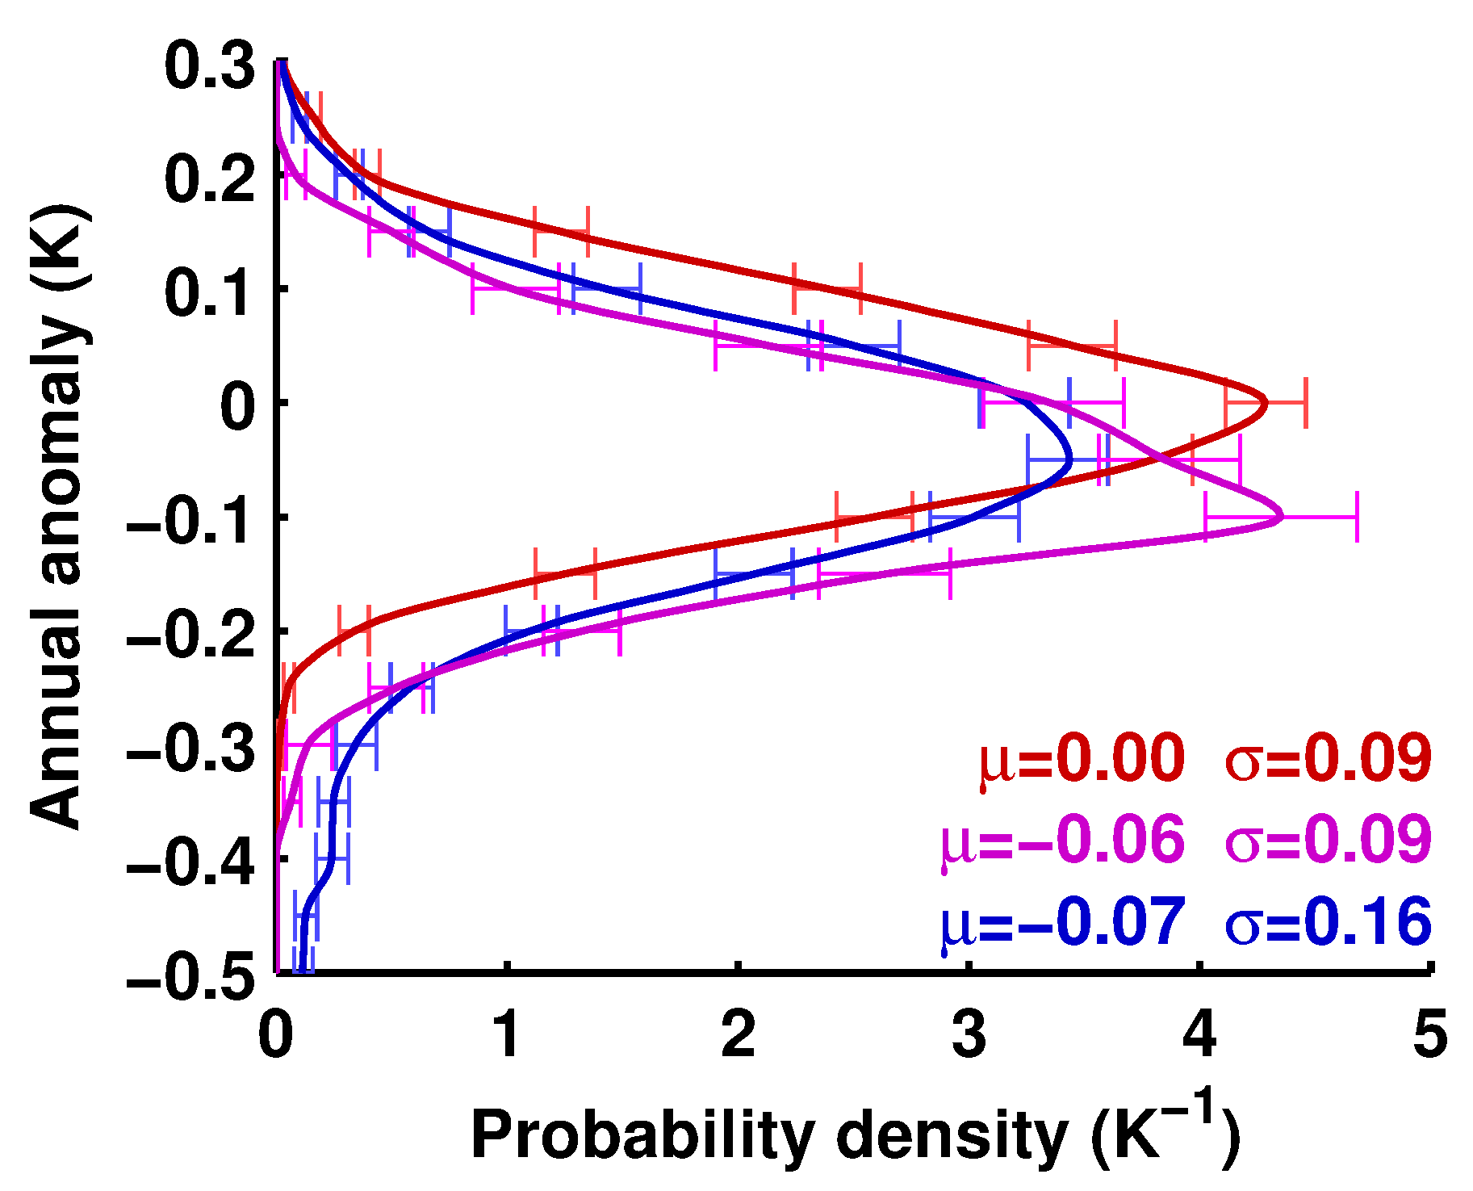
Global-mean annual surface air temperature
Outline Background Methods Results Summary
NO-VOLC
VOLC
VOLC-CONST

Slide 27
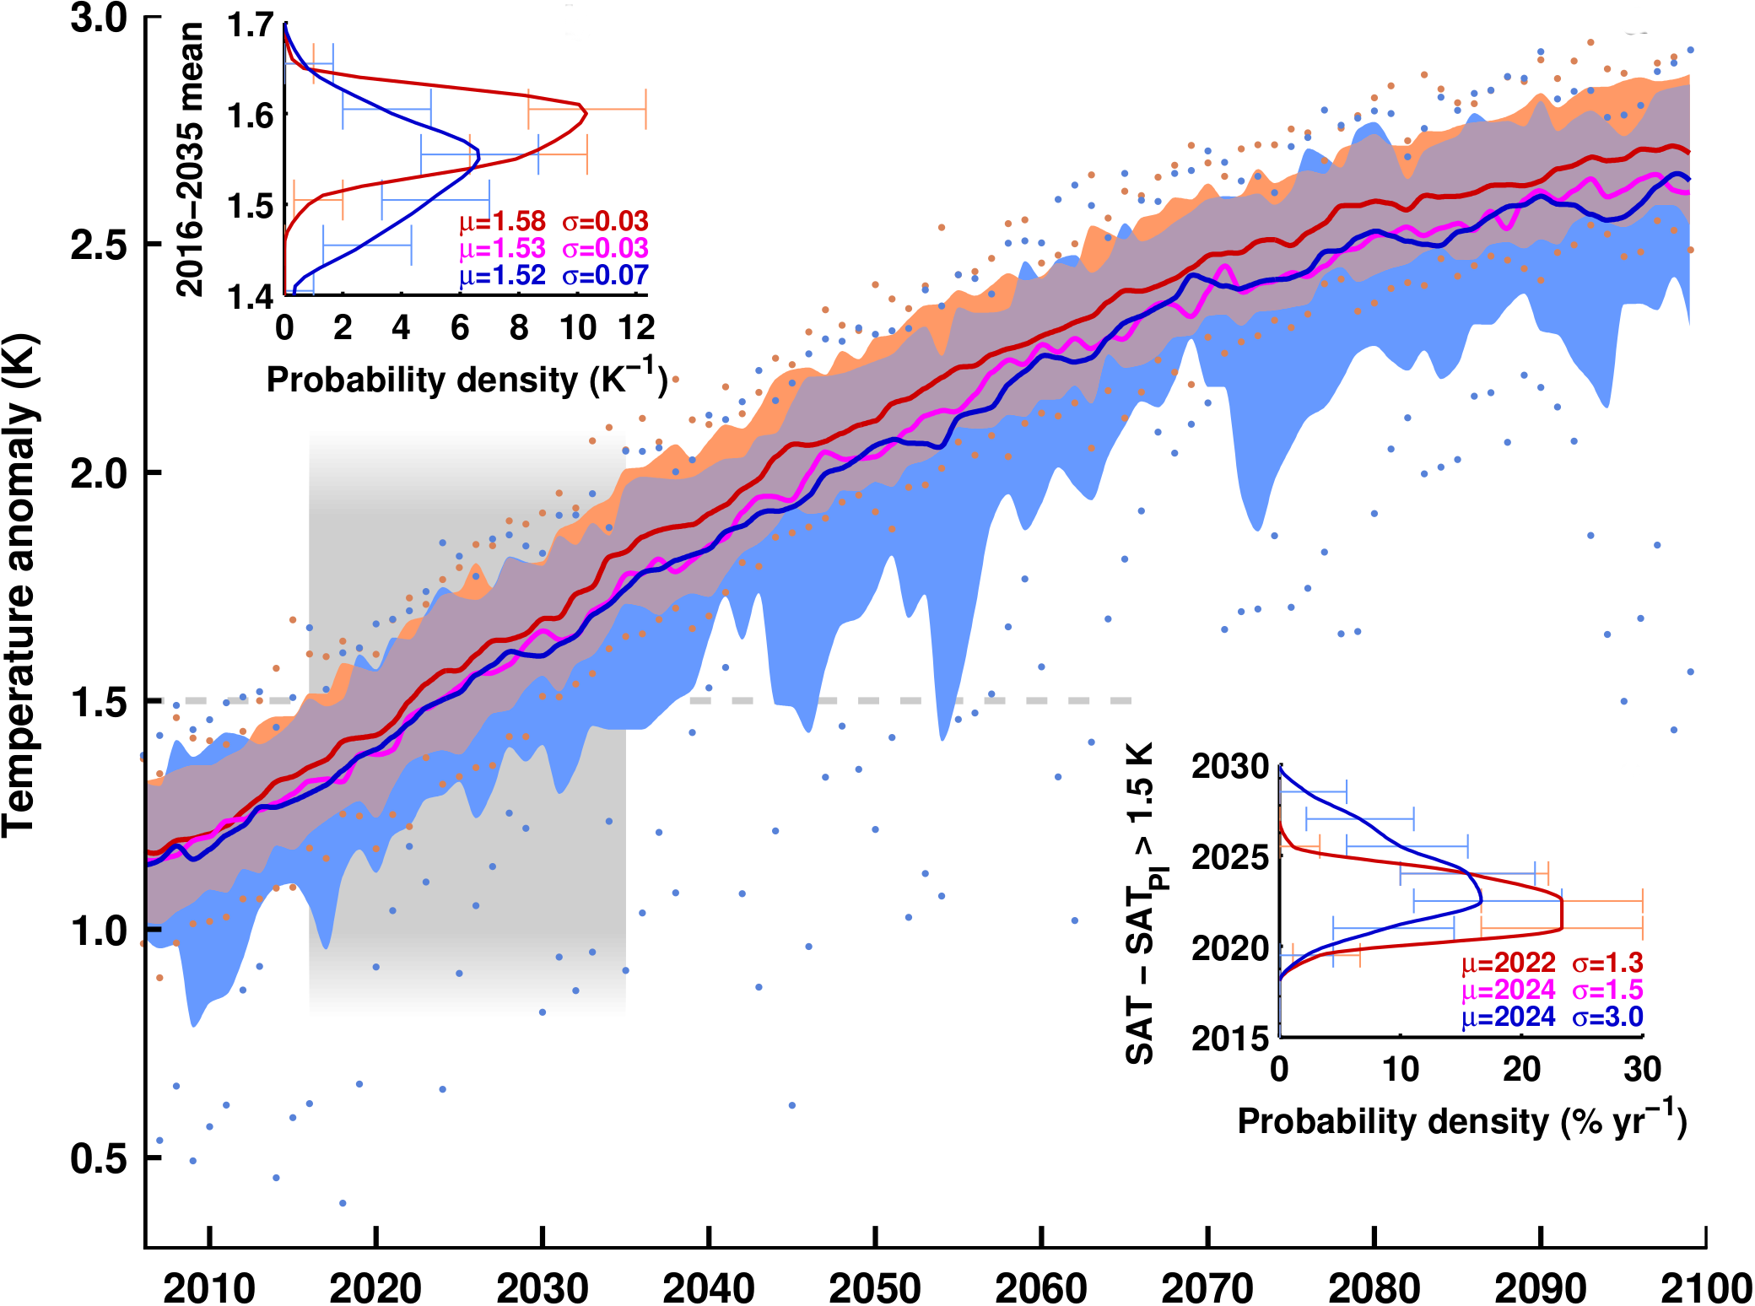
Global-mean annual surface air temperature
Outline Background Methods Results Summary
near-future temperature change
time warming
hits 1.5C

Slide 28
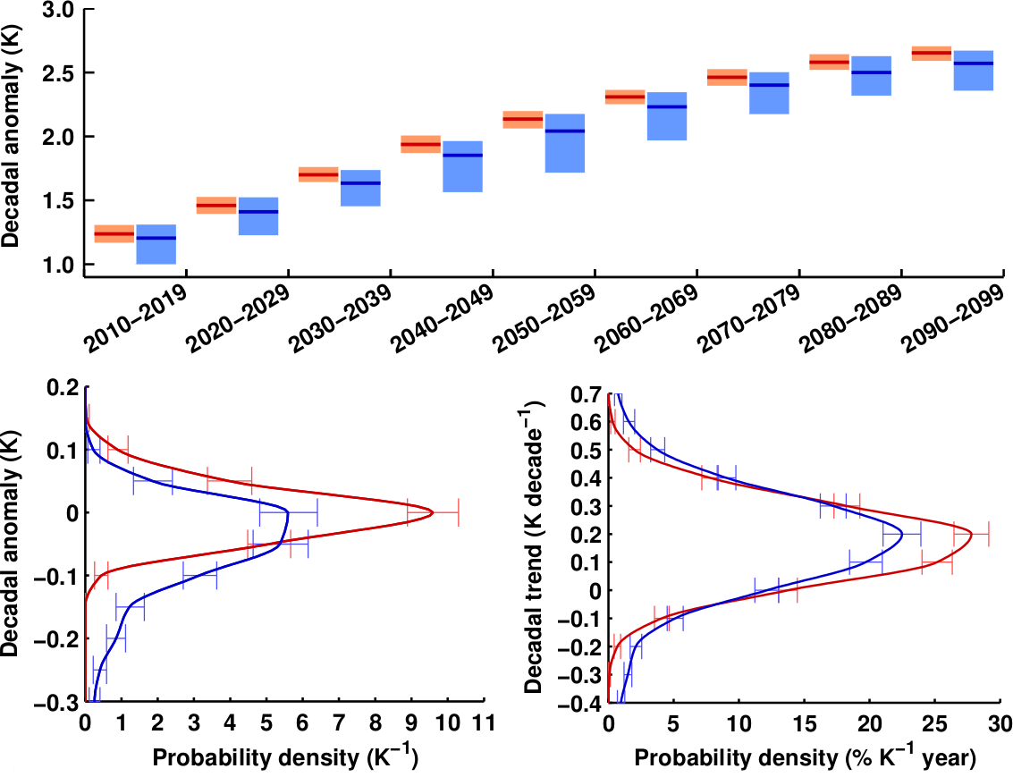
Decadal temperature means and trends
Outline Background Methods Results Summary
decadal mean
95%
mean
5%
decadal mean
decadal trend
std = 0.04 K
std = 0.11 K
std = 0.12 K/10-yr
std = 0.24 K/10-yr
anthropogenic warming removed

Slide 29
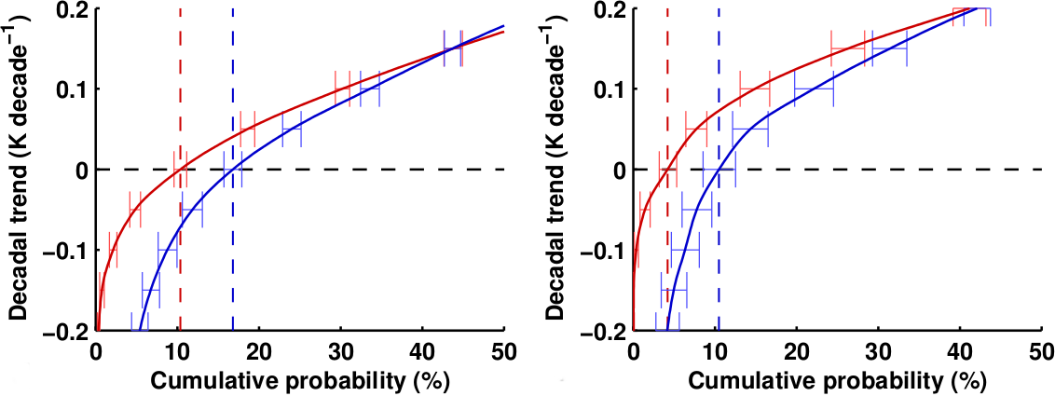
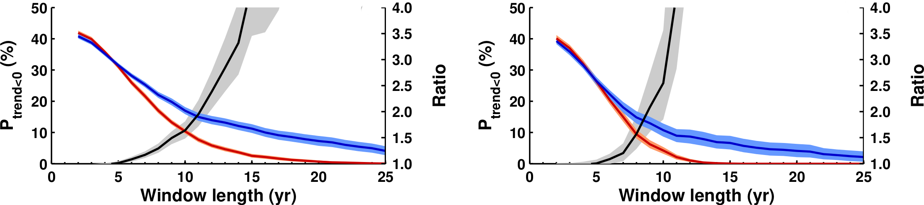
Global warming pause probability
Outline Background Methods Results Summary
All years
2006–2050
50% increase in hiatus decades
P(y<0) = 10%
P(y<0) = 16%
drg
relative importance of volcanoes increases for longer averaging periods

Slide 30
Global warming pause probability
Outline Background Methods Results Summary
All years
2006–2050
P(y<0) = 10%
P(y<0) = 16%
P(y<0) = 4%
P(y<0) = 10%
relative impact is sensitive to global warming scenario

Slide 31
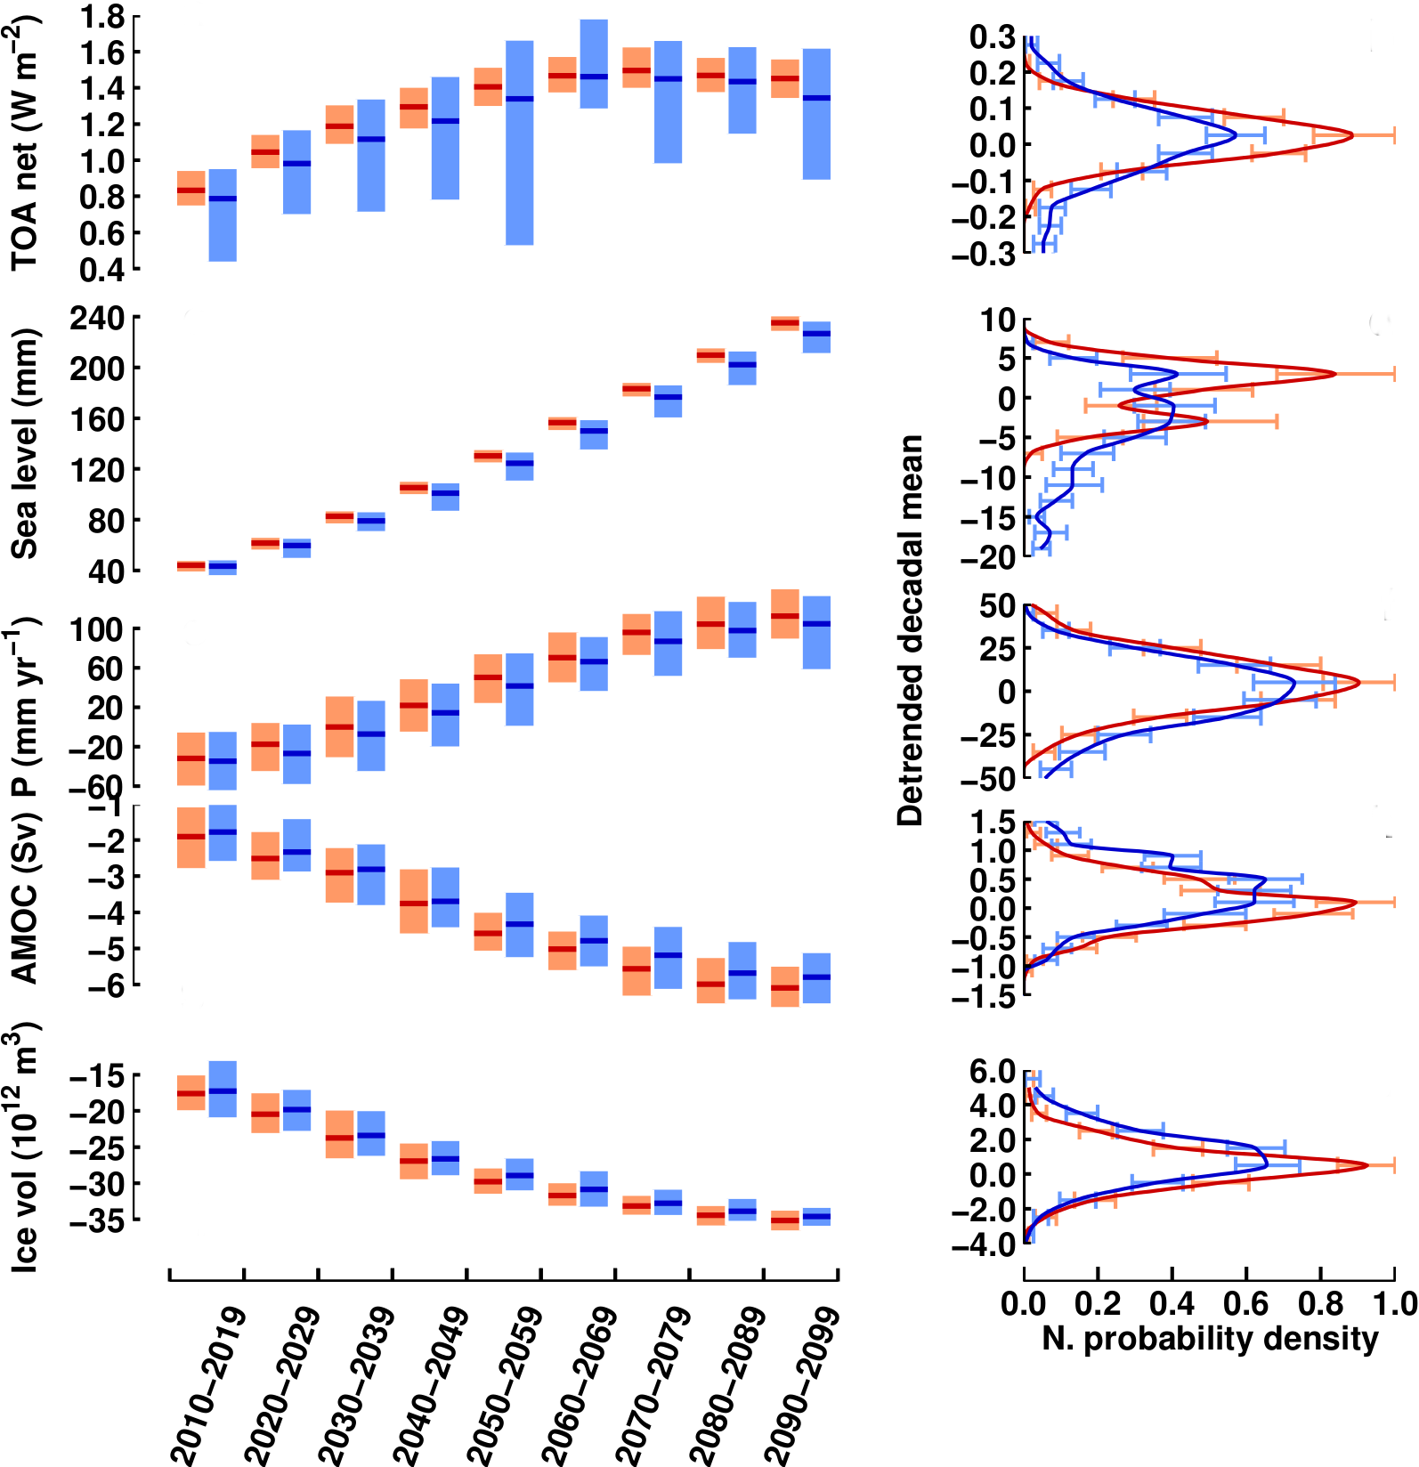
Large-scale climate indicators
Outline Background Methods Results Summary
Radiation balance at
top of atmosphere
Steric sea level change
East Asia summer
monsoon precipitation
AMOC strength
Arctic sea ice volume

Slide 32
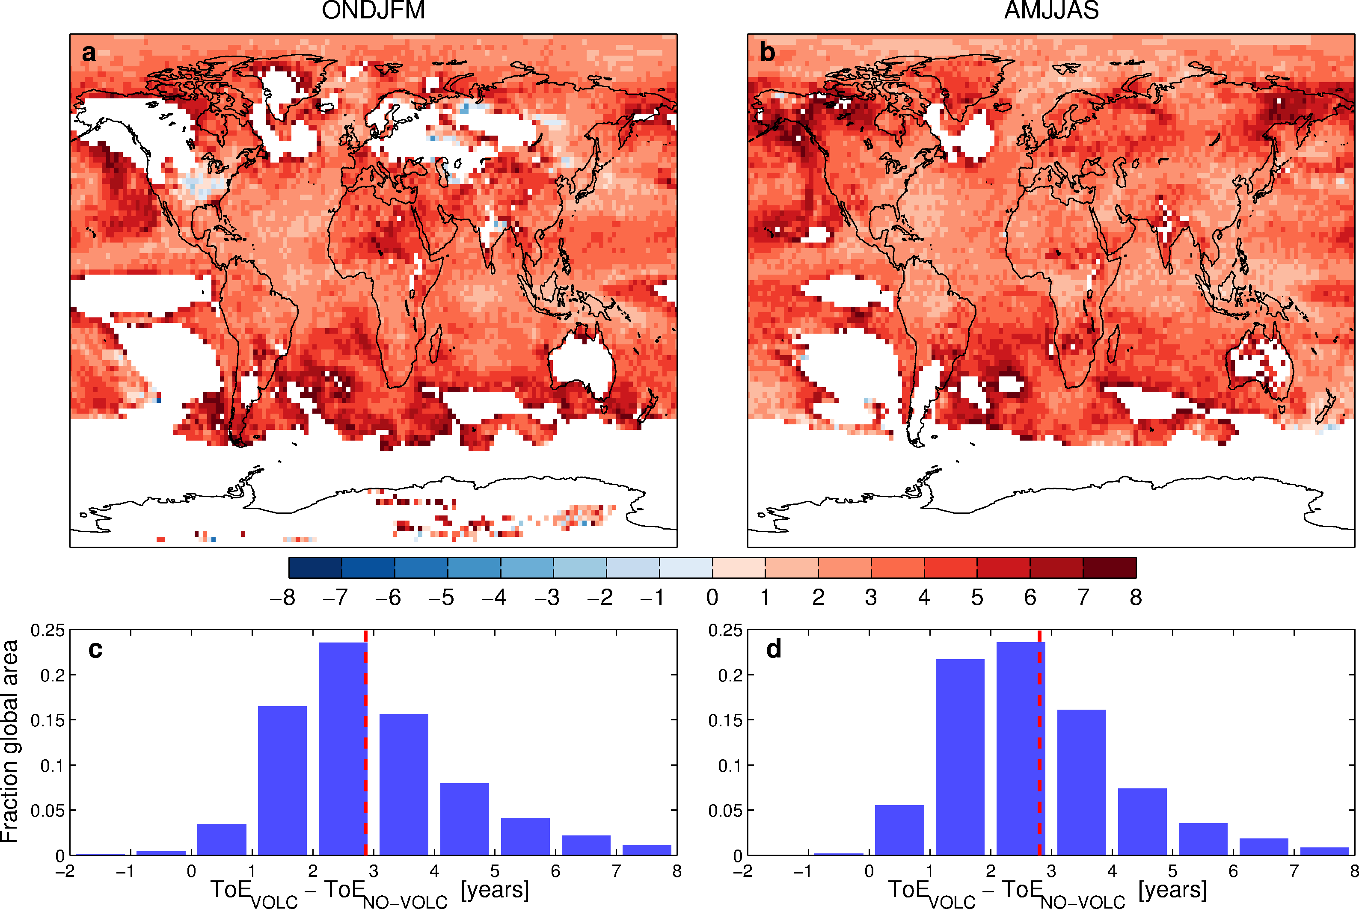
Does it matter locally?
Outline Background Methods Results Summary
Time of Emergence of global warming (VOLC – NO-VOLC)
[years]
local climate change is expected to emerge a few years later if volcanic effects are taken into account

Slide 33
Summary
Outline Background Methods Results Summary
demonstrated that volcanic forcing uncertainty can be included in future climate assessments (at high computational cost)
performed a large ensemble of 21st Century climate simulations that sample the probability space of future volcanic forcing
compared results to conventional projections with zero or constant volcanic forcing
found volcanic impacts on important aspects of 21st Century climate projections
general increase in projection uncertainty (to-be-quantified)
distribution widening for shortterm climate means and trends
50% increase in global warming hiatus decades
potential implications for climate adaptation decisions and risk assessments that focus on the spread and tails of distributions (to-be-identified)

Slide 34

Outlook
Outline Background Methods Results Summary
quantify volcanic contribution to total projection uncertainty and identify information relevant for the upcoming IPCC report
refine simulation strategy (e.g., combine probabilistic and scenario approaches) and make it more suitable for coordinated multi-model efforts such as VolMIP
address socioeconomic relevance through collaboration with regional climate impact assessments
follow up study for solar forcing
Krakatoa 2007

