Slide 1
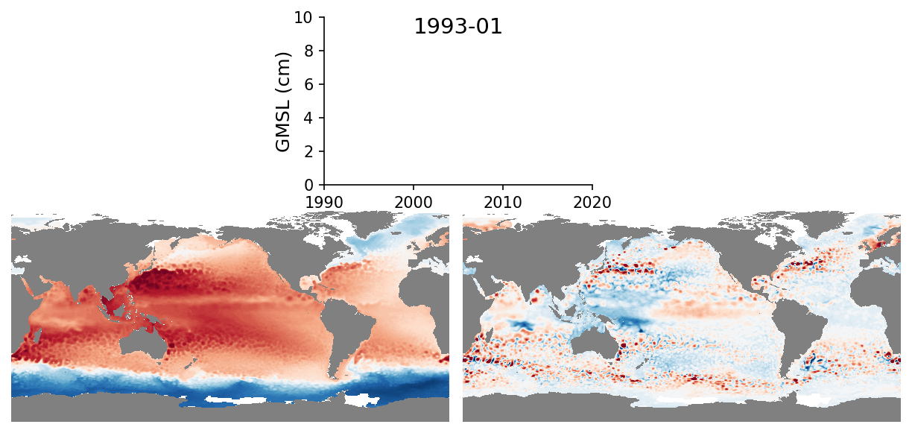
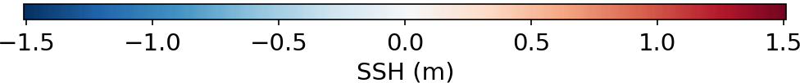
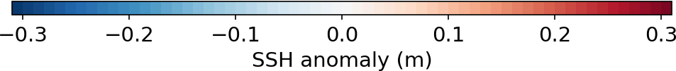
Sea level variability during the satellite altimetry era (1993–present)
Controls on sea level
Mass change
Mass redistribution
Thermal expansion
OBS: ARMOR3D (Guinehut et al. 2012, Ocean Sci.)

