Slide 1
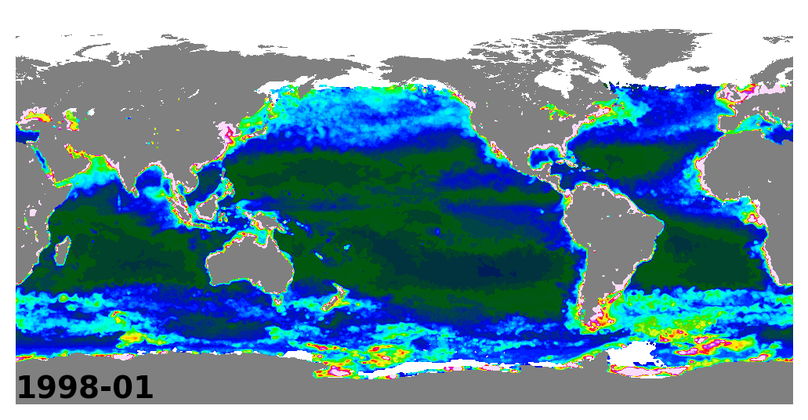
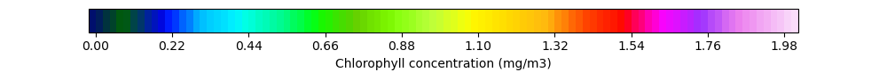
Monthly CHL concentrations from GlobColour 1998–2022

